Slide 1
App4App2Grad
Team 04
December 13th, 2022

Slide 2
Our Goals
Graduate Program Application
Student and Faculty Collaboration
Research Area and Staff Discovery
Graduate School Portal

Slide 3
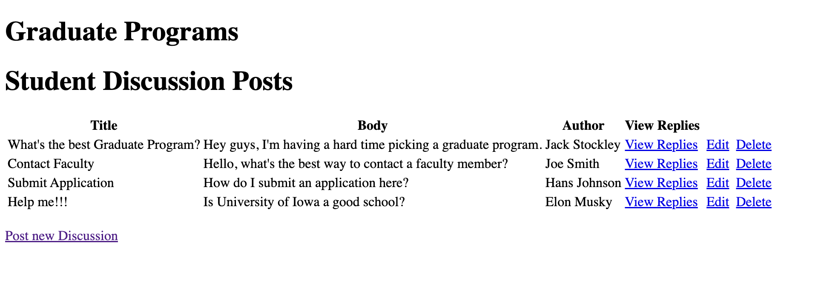
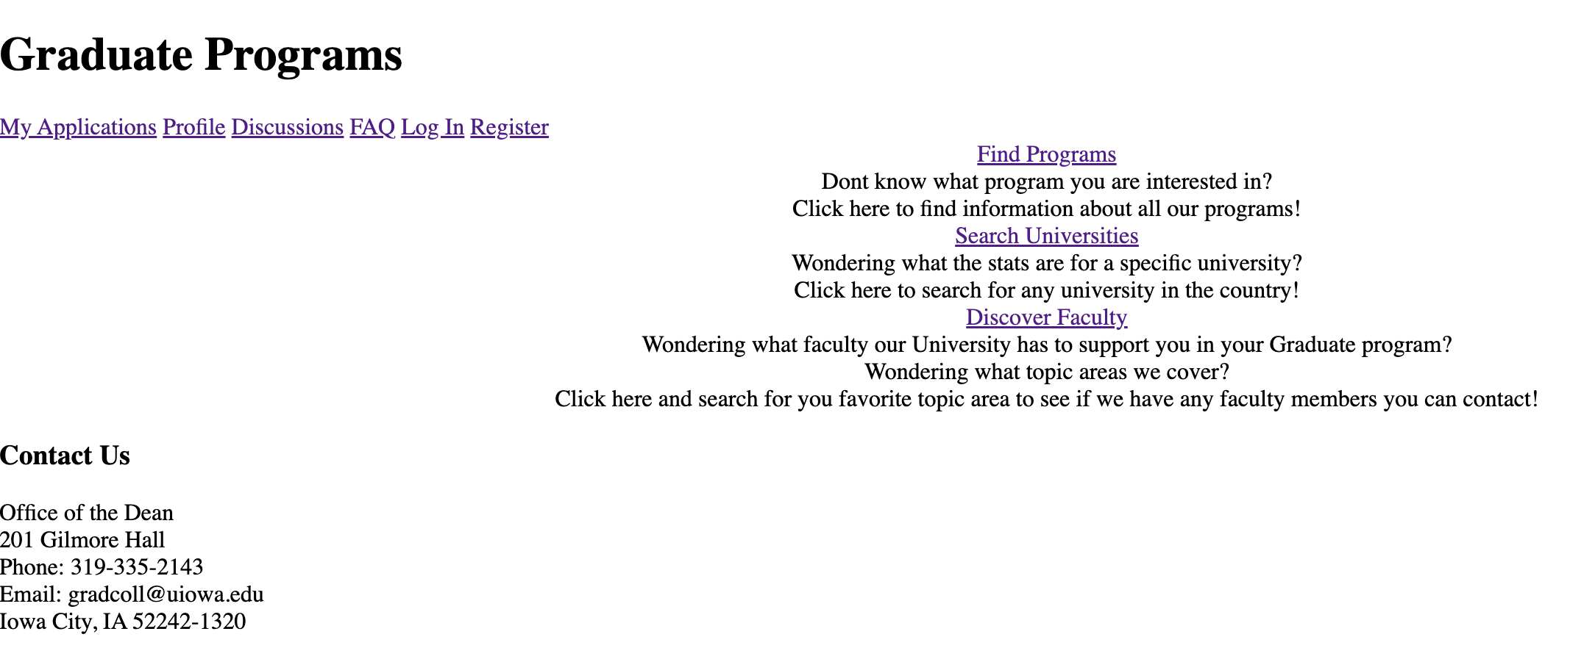
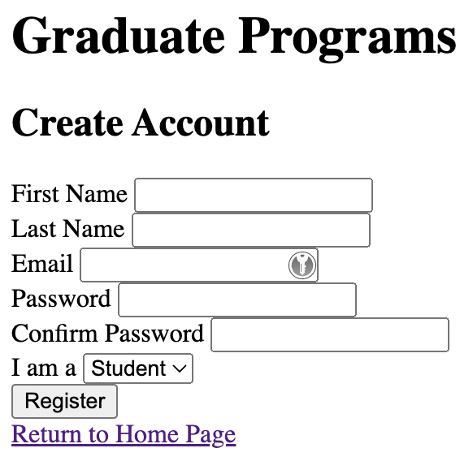
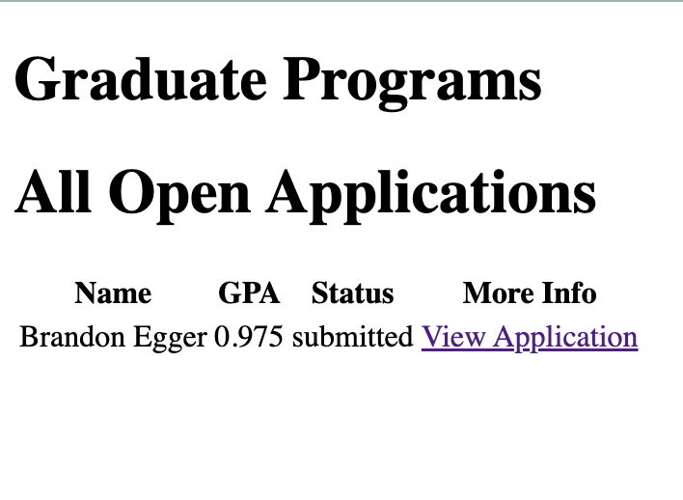
Sprint 1
Home Page
FAQ Page
Account Registration
Discussions

Slide 4
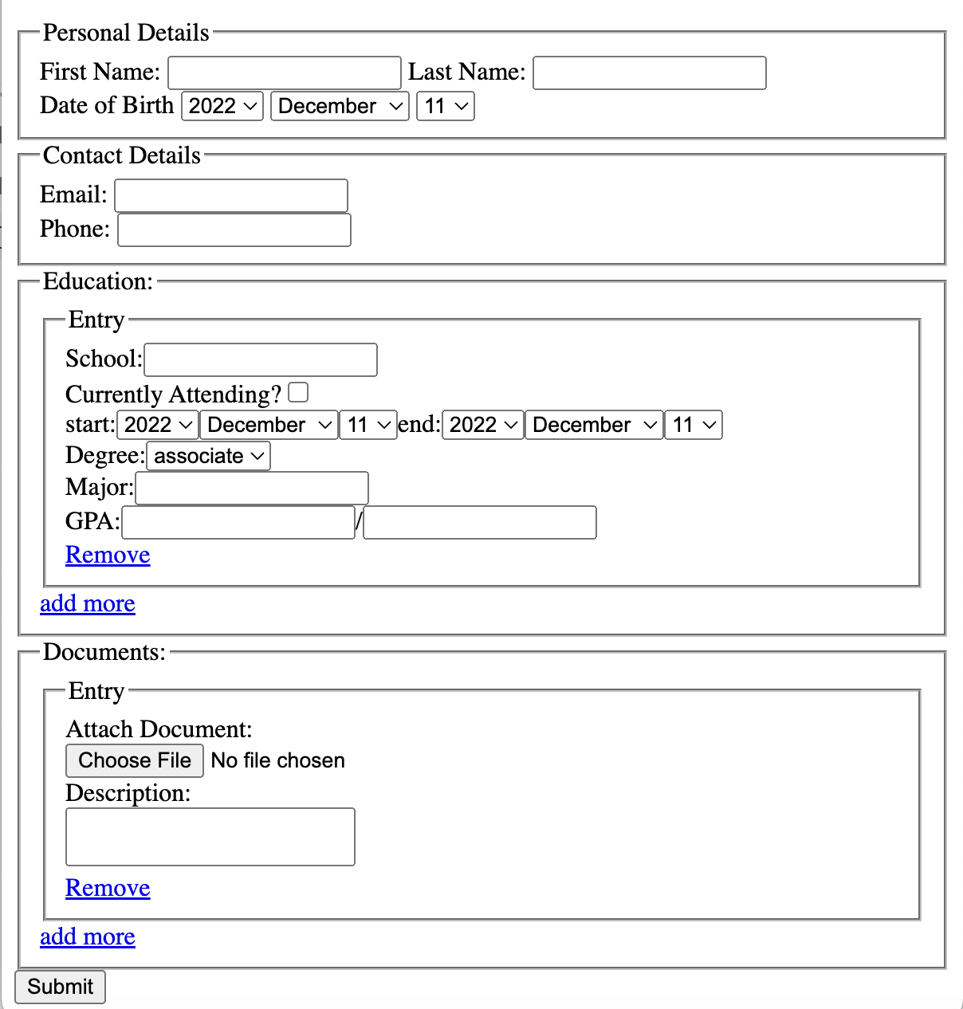
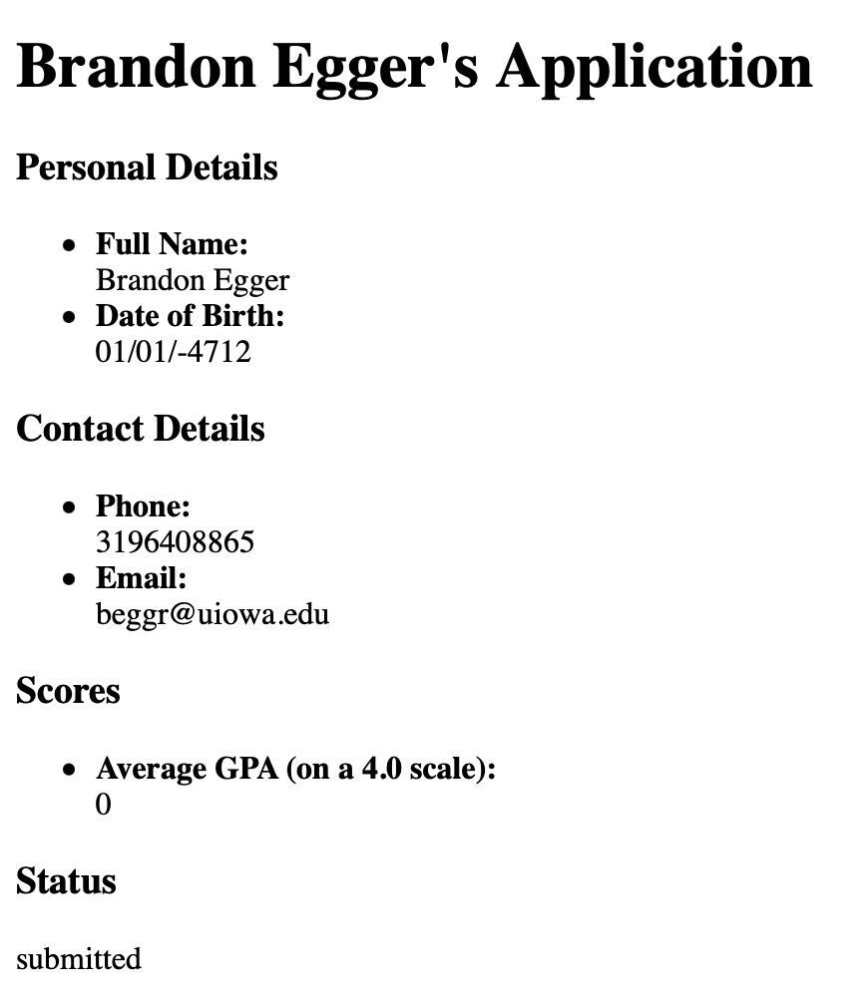
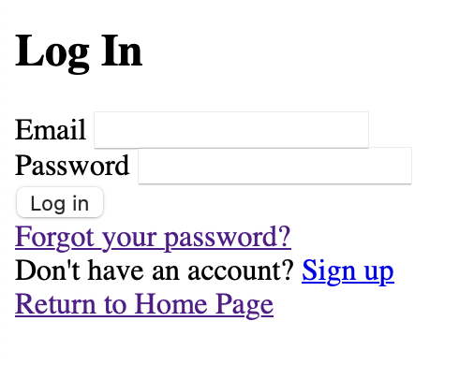
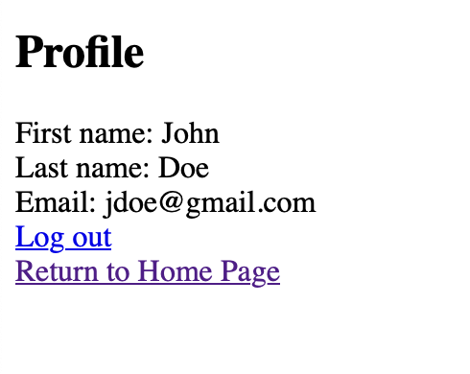
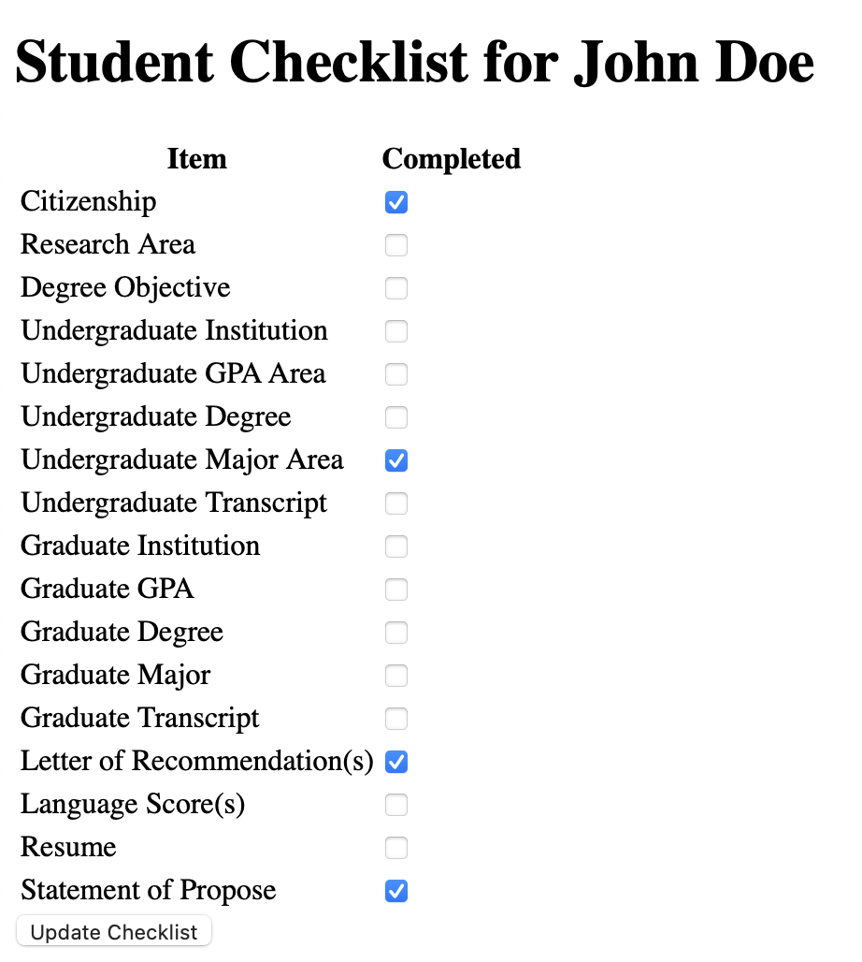
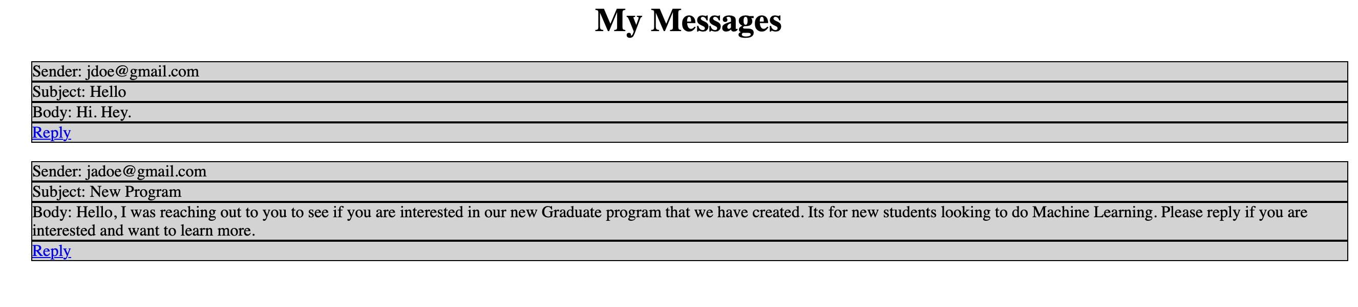
Sprint 2
Secure Login
Student Checklist
Messaging
Submit Application
Uploading Documents
Notes:
Continuing off from Sprint 1 we implemented our Secure Login feature, allowed student to complete a checklist of items for their application, implemented messaging between students and faculty members, and allow students to submit an application, and include any documents that are required while filling out the application.

Slide 5
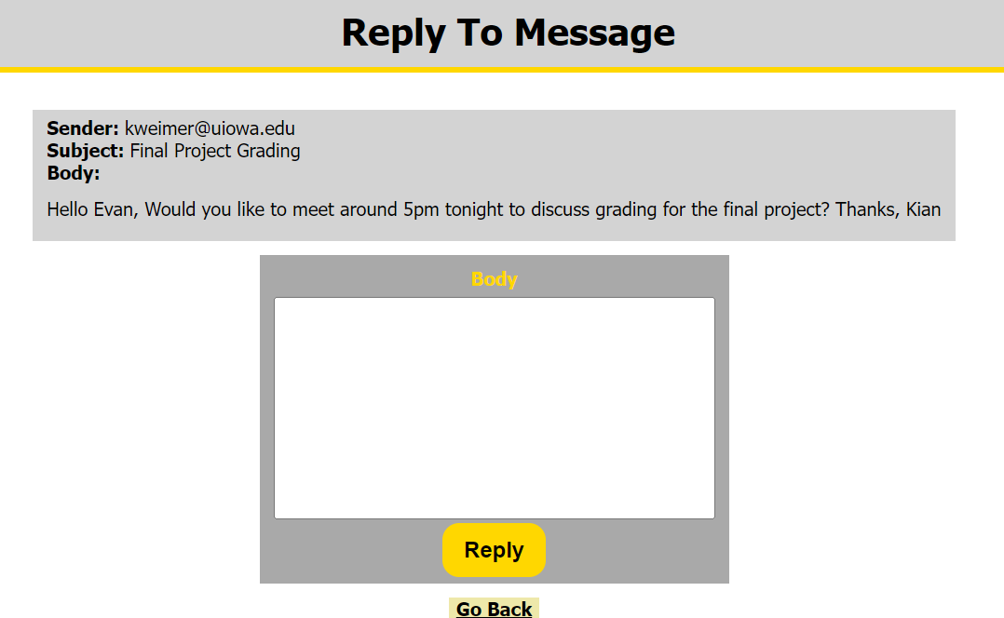
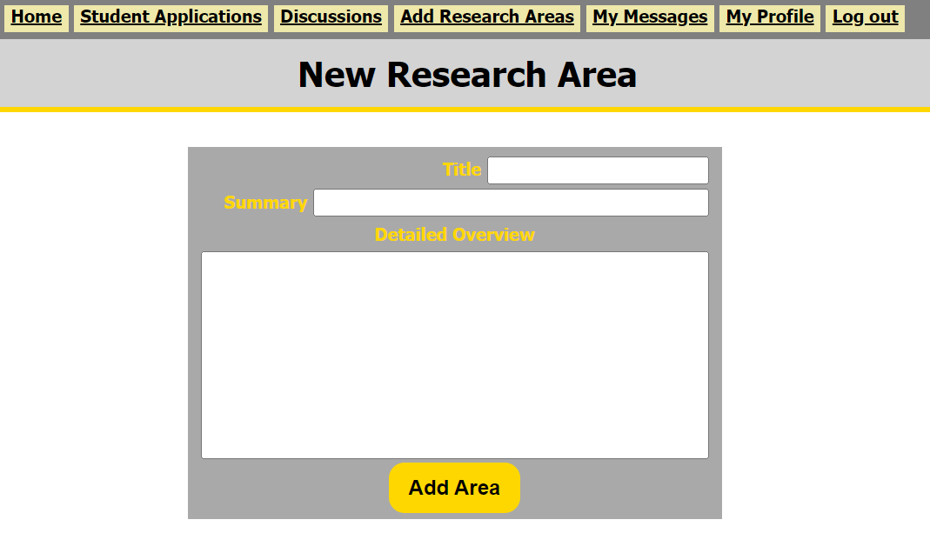
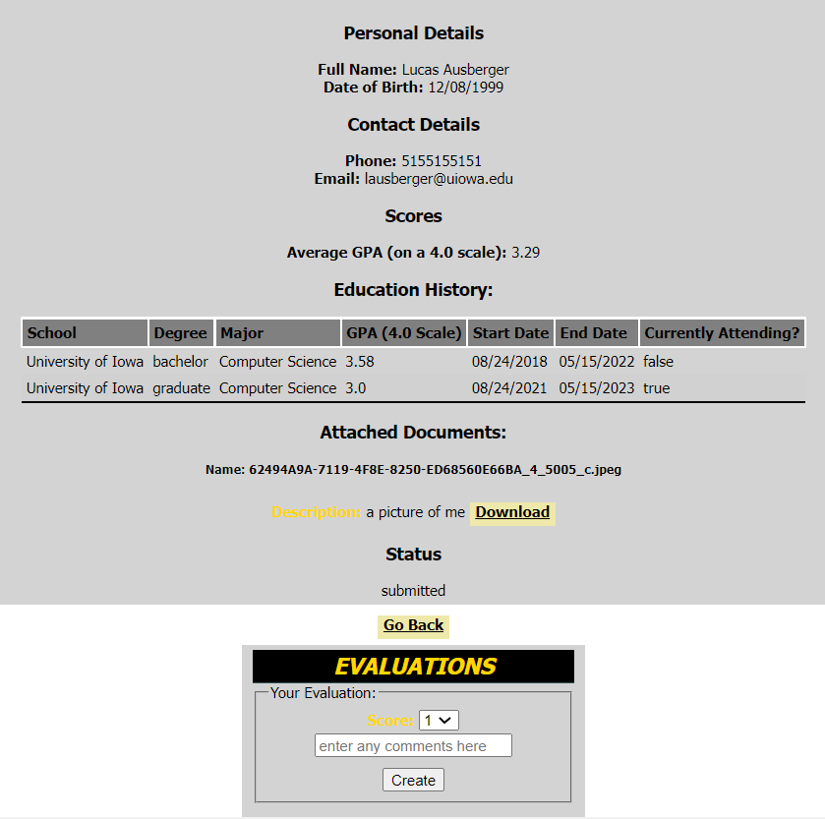
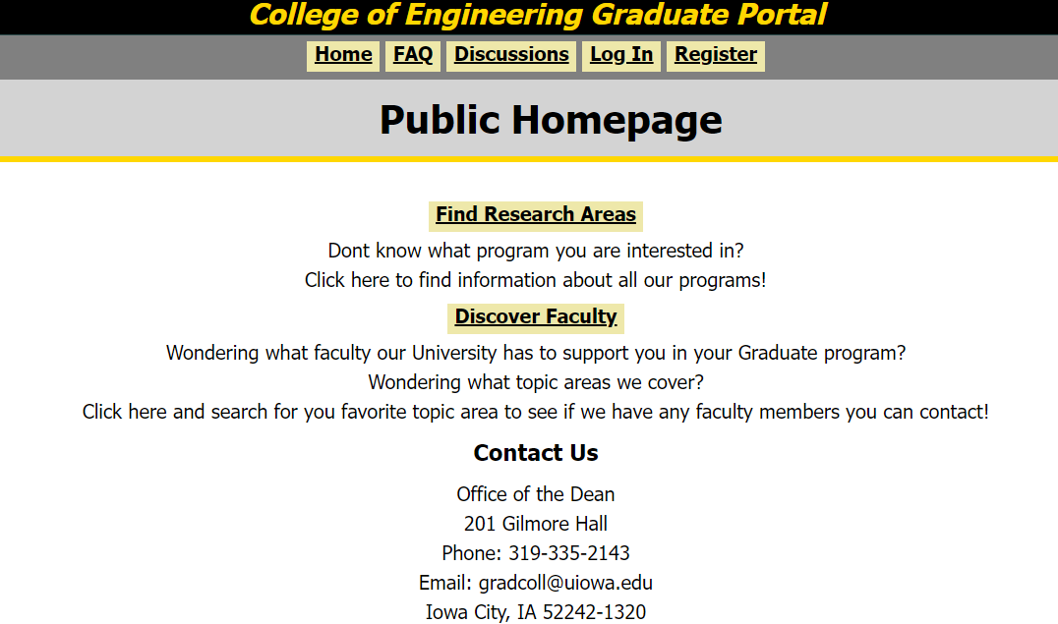
Sprint 3
Research Area Discovery
Faculty Discovery
Adaptive Navbar
Evaluating Applications
Message Replies
Notes:
Finally in Sprint 3, we implemented a way for student to discover all faculty members or narrow their search down to a specific research area and learn more about that area as well. We also implemented our adaptive navbar, so the most relevant features are available depending on the signed in user. Lastly, we implemented a way for department chair and faculty members to evaluate a student's application and a way for users to reply to private messages they received. Now we’d like you show you a quick video demo of some of these features.

Slide 6
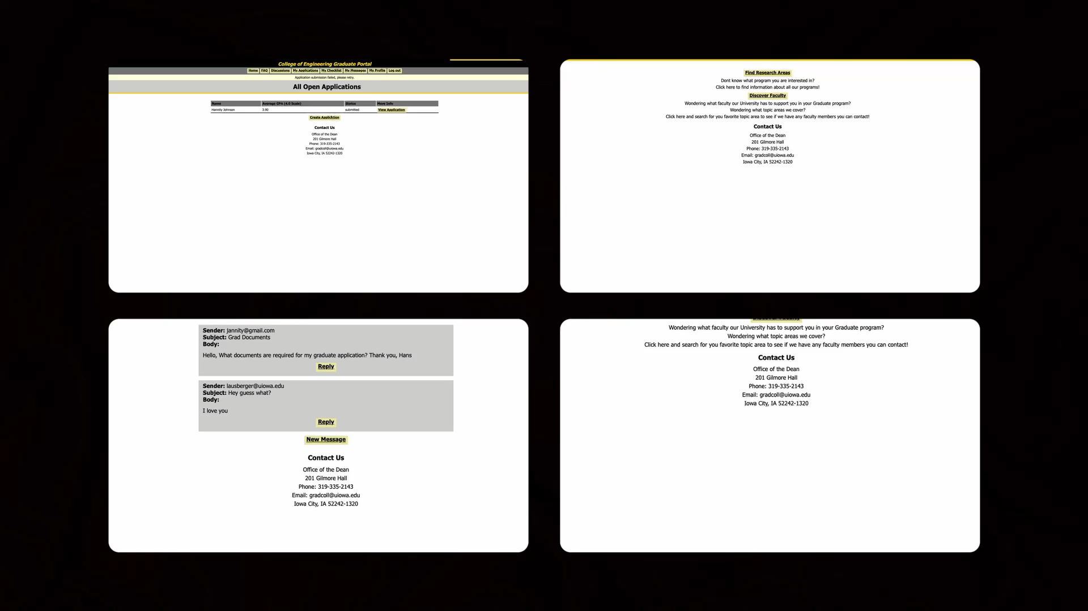
Demo

Slide 7
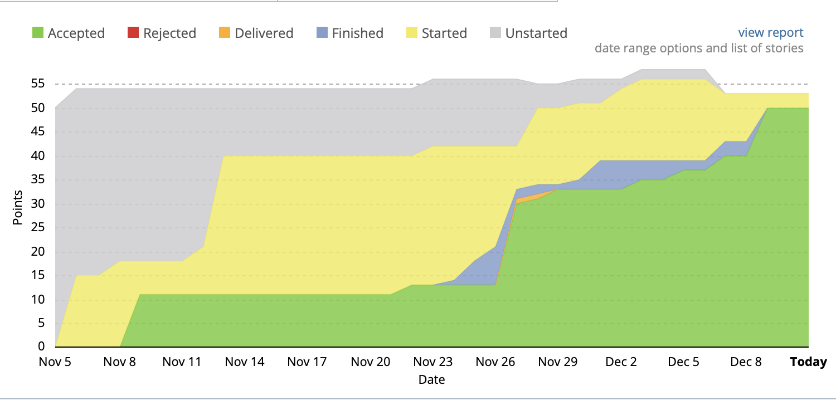
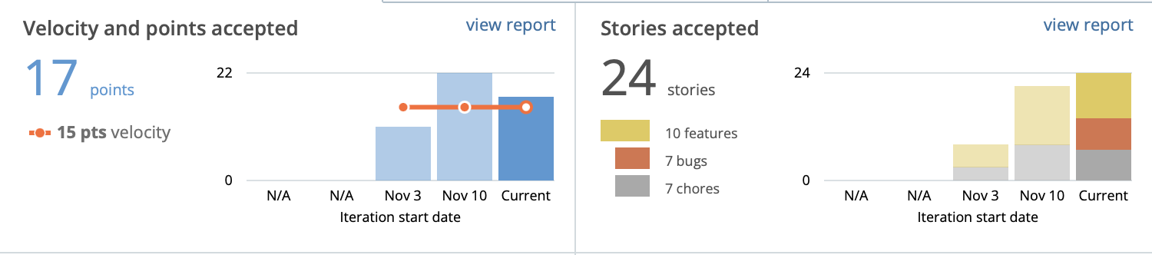
How We Did It
Pivotal Tracker
Meetings
Mon, Wed, Fri: 11:15-11:30am
Sun: 2:00-3:30pm
Wiki Pages
Testing
Git Procedures
CI/CD Pipeline
Notes:
Procedures/Processes
Touch on how Pivotal Tracker points stayed consistent, backlog mostly done
Meetings Scrum/Sunday friction

Slide 8
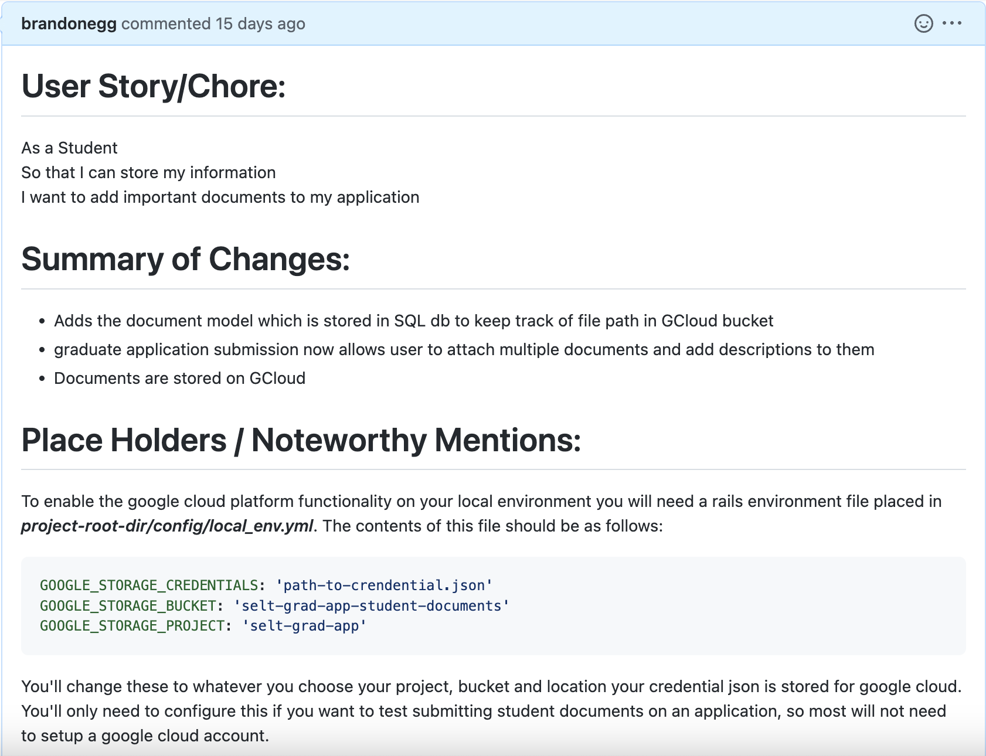
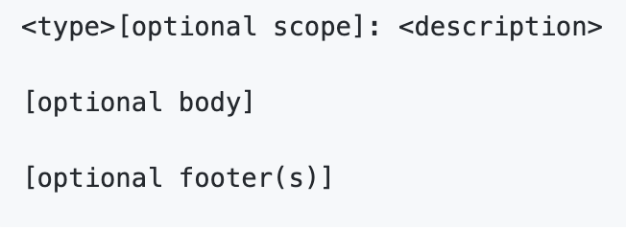
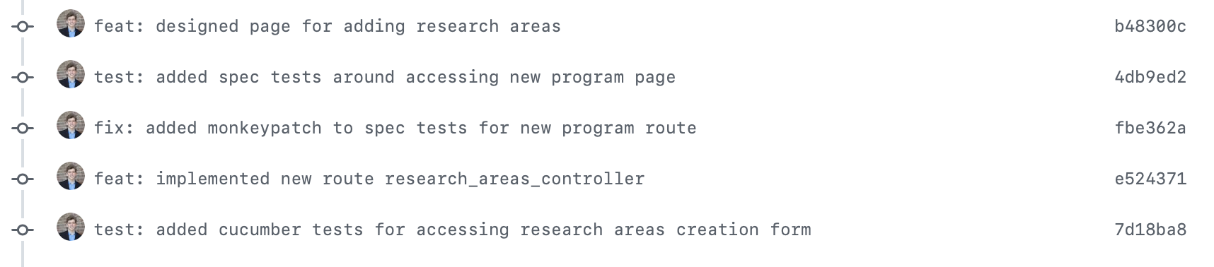
Git Procedures
GitHub pull request template:
Feature details
Screenshots
Other developer notes
PR Approval:
2 approved reviews
Pipeline jobs succeed
No conflicts
Commit message format:
Notes:
So regarding git procedures, we had a fairly extensive process for handling pull requests.
All of our team would have individual feature branches for each feature they were working on
When this feature was deemed complete by the engineer, they would create a pull request for it
Our pull requests followed a template which you can see on the screen here covering a few things to help the reviewer
One was the story itself, since its pretty inconvenient switching between gitub and pivotal and trying to find what they were working on
A brief summary of changes also could help clarify why certain files were edited
Place holders for noting anything important for current reviewers and future visitors
Screenshots for viewing any visual changes
Our PR also required at least two other eyes to approve the changes, to ensure we maintain quality in our codebase
Commit messages were also structured, this also helps in the review process as good commit messages can briefly describe exactly what they are changing

Slide 9
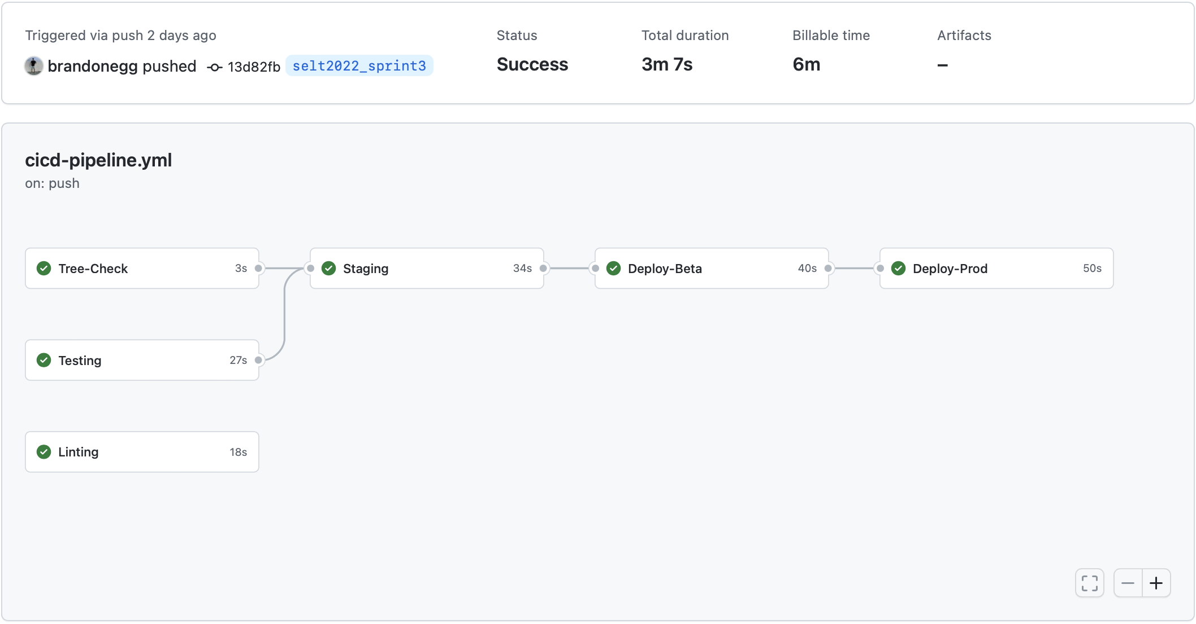
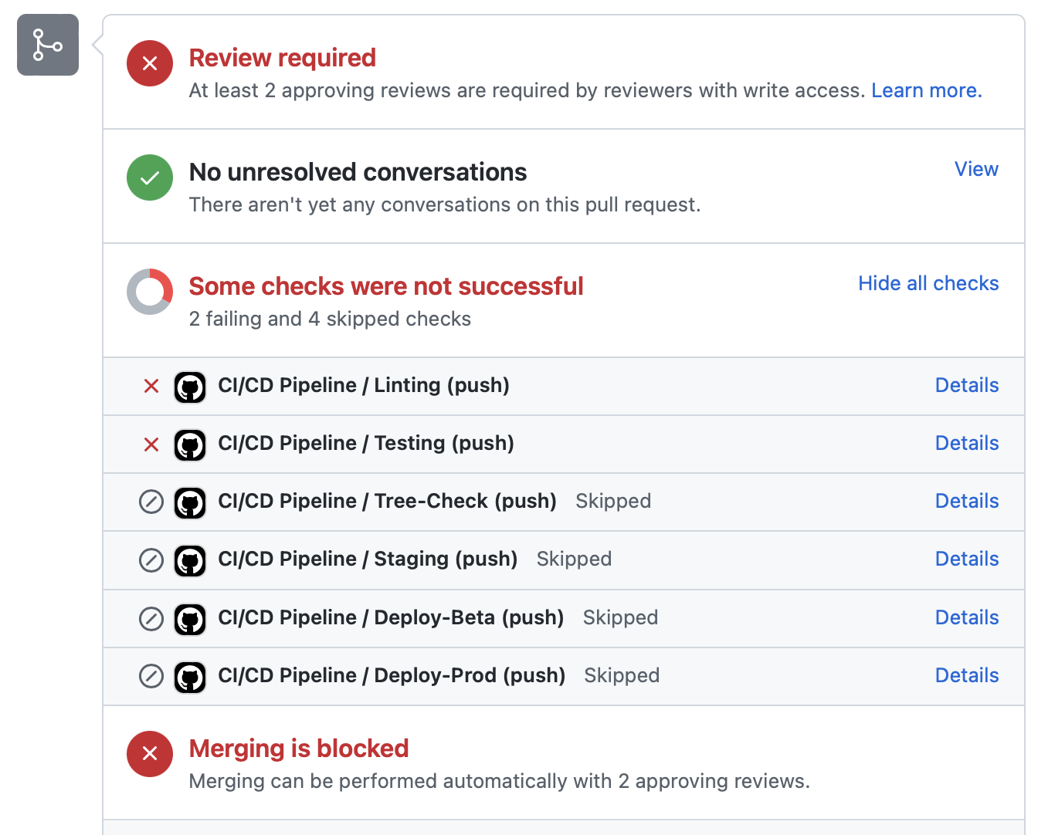
GitHub Actions Pipeline
CI/CD
Any Push -> Local
Approved PR -> Beta
Tagged Release -> Prod
Stages
Linting
Spec/Feature Tests
Local Staging
Deploy to Beta Site
Deploy to Prod Site
Benefits
Breaking changes never end up in production
Streamlines reviewing of pull requests
Developers focus on developing
Notes:
One of the ways we maintained the health of our repository was through our continuous integration, continuous deployment pipeline
This pipeline automates a series of checks in a neutral environment, any time changes are pushed to the remote
For approved pull requests, a deployment is made to our beta website, allowing us to test all the latest features as they are implemented throughout the sprint
Tagged releases will then trigger a deployment to the appropriate production channel for a given iteration
This pipeline helped catch subtle bugs, greatly streamlined our review process, and cut out repetitive tasks, meaning that the developers can focus on developing

Slide 10
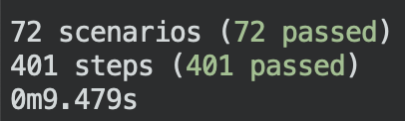

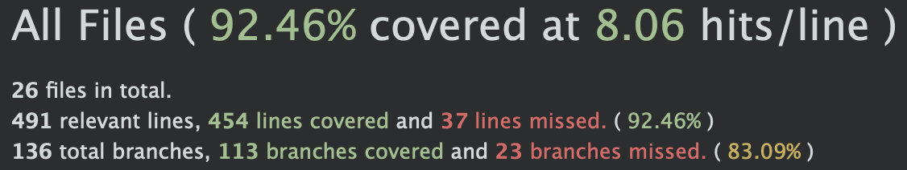
Testing
Each teammate was responsible for their features
BDD
Cucumber
Capybara
TDD
Rspec
FactoryBot
Coverage
Generated with SimpleCov

Slide 11
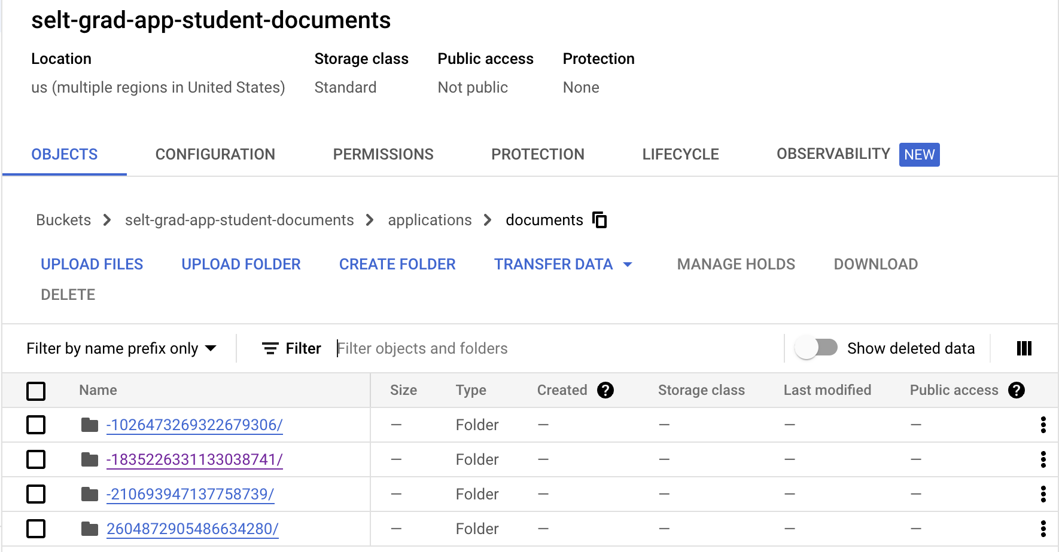
Technologies
Framework
Ruby 2.6.6 on Rails 4.2.10
Haml
Google Cloud Storage Gem
Student document upload
Secret API key stored on Heroku
JavaScript
Enables has_many form creation with belongs_to parent
Application educations/documents
Bcrypt Gem
For encrypting passwords stored in database

Slide 12
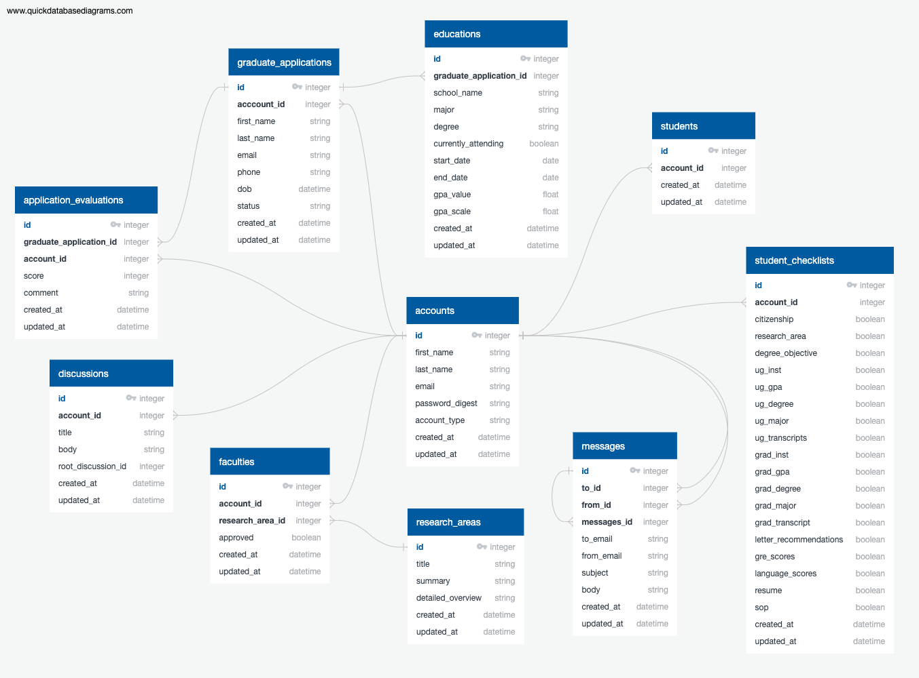
Database Schema Overview

Slide 13
Lessons Learned
Protected main branch and pipeline necessary
Element ID selectors for resilient Cucumber tests
Marking features complete when they are complete; not at end of sprint
Better point estimation for features
Consider blockers when planning

Slide 14
Live Demo

Slide 15
Questions?

